Slide 1
BIOE 498 / BIOE 599 Advanced Biological Control Systems Lecture 1: Course Introduction
Joseph L. Hellerstein
January 3, 2024
eScience Institute, Computer Science & Engineering
Allen School of Computer Science
BioEngineering
Notes:
Diverse students. Some with bio-backgrounds; some without. Some with CS background; some with very limited. Two separate courses combined because of a substantial shared curriculum.

Slide 2
Agenda
What is control engineering and why it’s important
Course overview
Control system concepts
Example of controller design

Slide 3
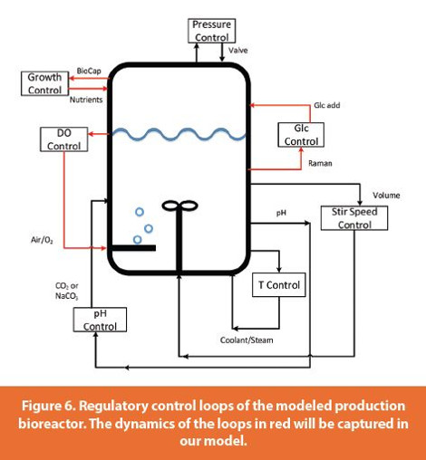
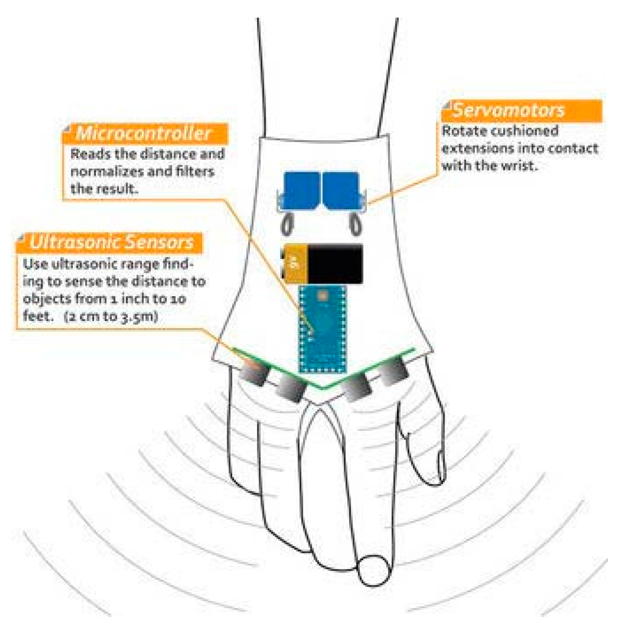
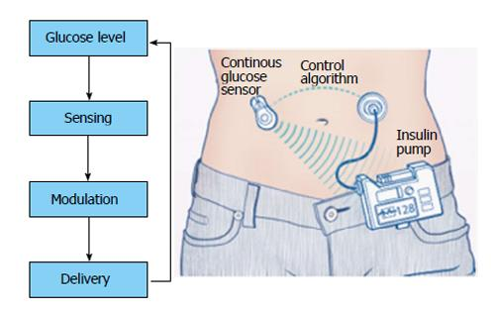
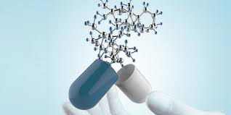
Why Control Engineering?
Bioreactor Control
Medical Device Control
Insulin Control
Create a system that:
ensures that bounded inputs produce bounded outputs;
regulates its output;
tracks a desired objective;
minimizes cost, energy, potential dangers.

Slide 4
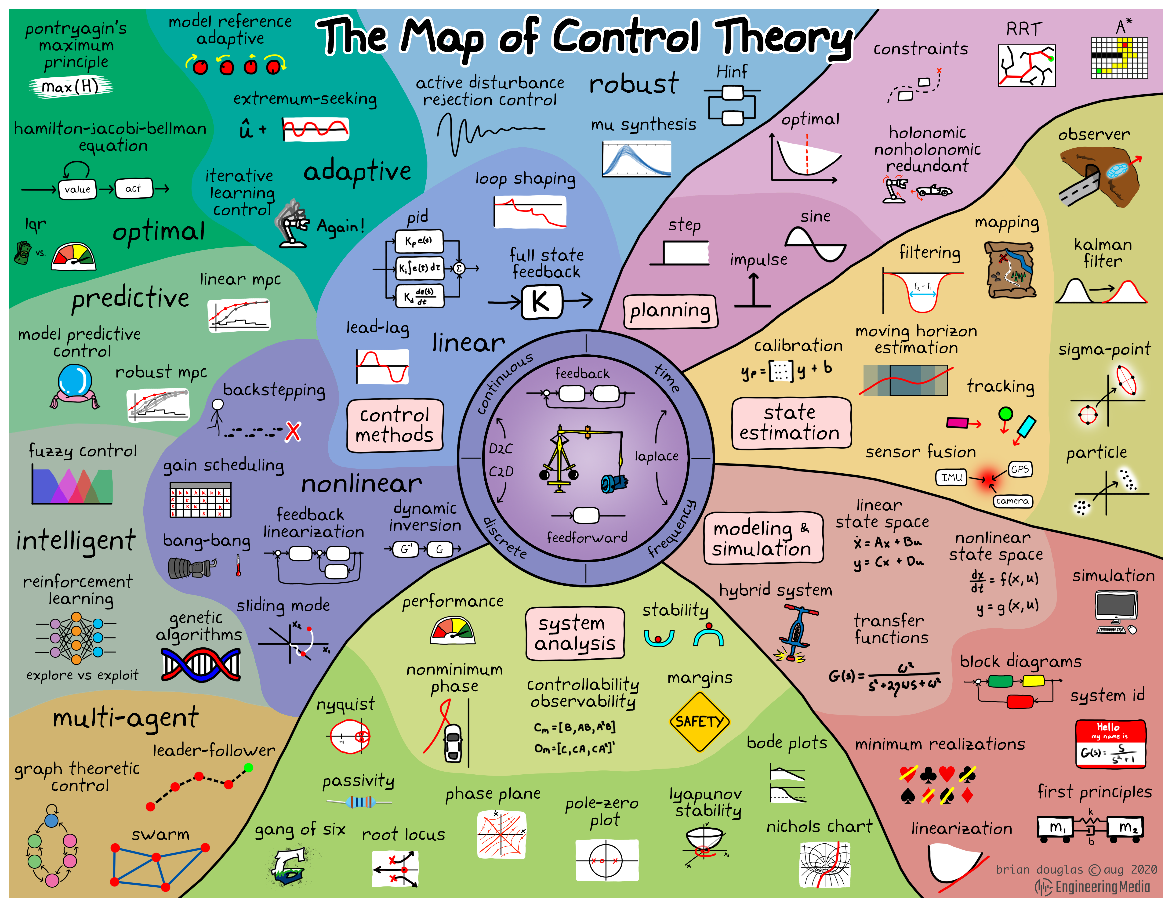
Control theory is a branch of applied mathematics that deals with the design of control policies for actuated dynamical systems. Control engineering is a cross-discipline field which applies control theory to a wide range of systems such as industrial plants, aerospace, robotics and more.
Brian Douglas

Slide 5
Structure of the Course
Control concepts
Testbed construction
Theory (Linear time invariant (LTI) systems)
Design & evaluation

Slide 6
Learning Objectives
Know core concepts in control engineering
Signal, system, PID control
Build testbeds for biomedical closed loop systems
Know basic LTI theory
Transfer functions, interpreting time domain behavior
Design & evaluate closed loop systems

Slide 7
Instructor
Joseph Hellerstein, Senior Fellow eScience Institute, Affiliate Professor CSE
PhD in Computer Science
Industry (30+ years): IBM Research, Microsoft, Google
Mathematical models of distributed computing systems
Current research
Modeling evolution of microbial communities
Model Engineering (tools for building biomedical models)

Slide 8
Grading
Homework (2 assignments): 50%
Final project: 50%
End-to-end analysis and design of a feedback control of an SBML model

Slide 9
Submitting Homework
Create your folder here. Only you and the instructors have permissions for the folder.
Upload your assignment to the folder before the due date.

Slide 10
Resources
Python
Python programming
Python Data Science Handbook
Python for control engin eering (Part VIII)
Control Engineering
Modern Control Engineering, Ogata
Linear Systems - Theory and Design, Chi-Tsong Chen
State Space Design (YouTube), Jake Abbott (University of Utah)
YouTube playlist for control engineering
Steve Brunton Control Boot Camp
Control Systems Design Online

Slide 11
Software
The class will feature in-class exercises, so please bring a laptop to class
Software: Tellurium (http://tellurium.analogmachine.org/)
For detailed installation instructions see https://github.com/sys-bio/tellurium#installation-instructions
For a huge database of curated models see:
https://www.ebi.ac.uk/biomodels/
Other packages
control – CalTech package for control systems design
controlSBML – Control design with SBML models

Slide 12
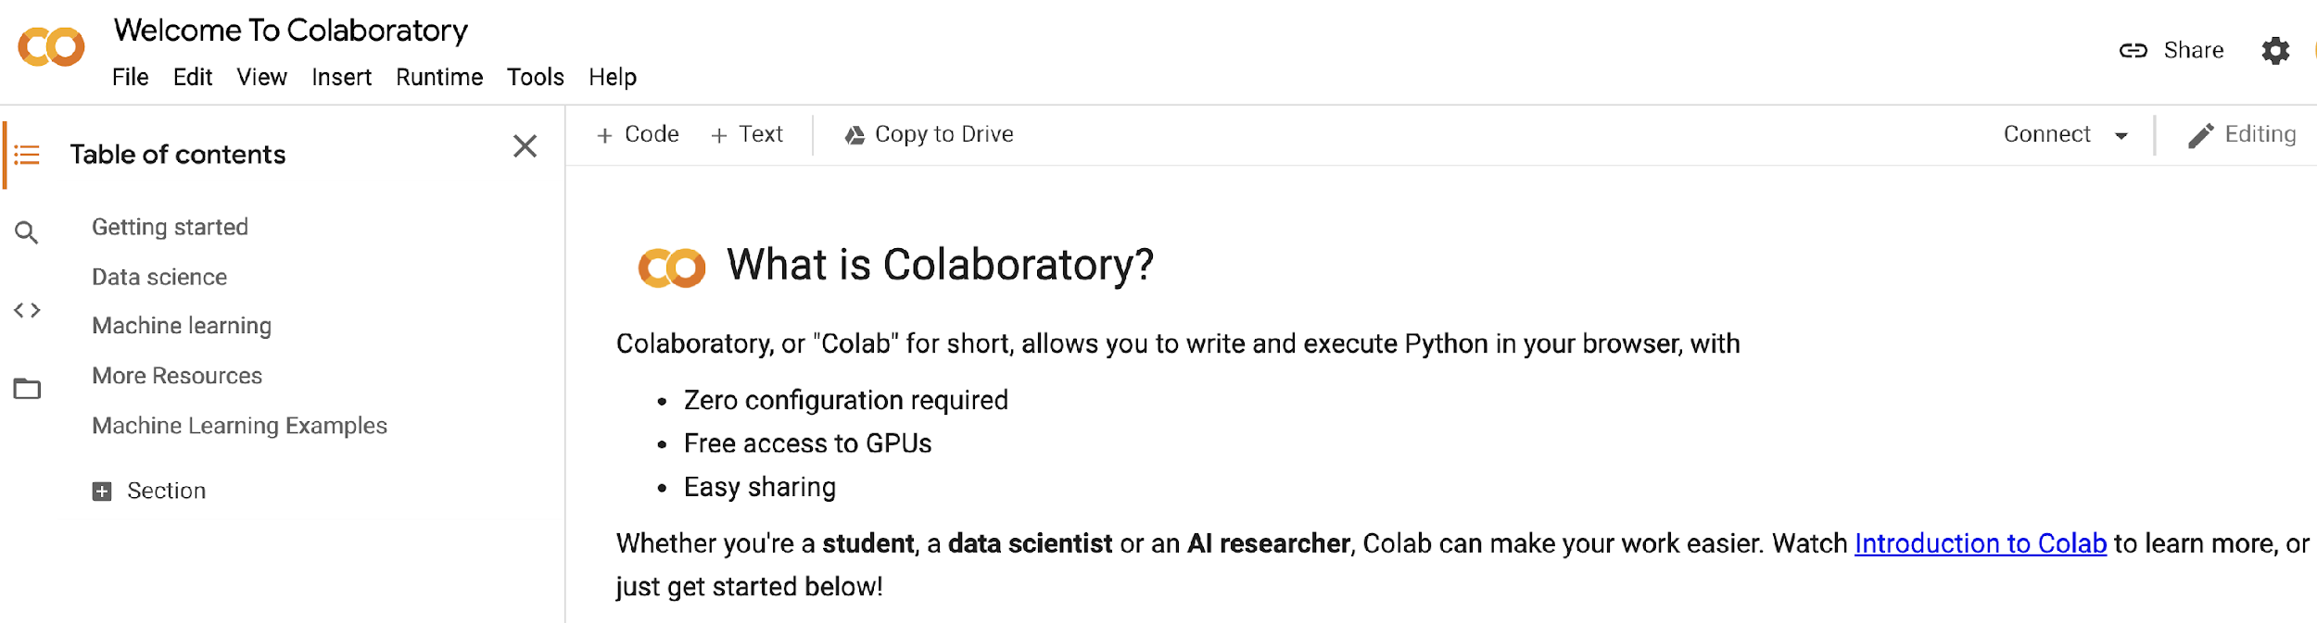
Getting Google Colaboratory (Colab)
We will use Google Colab for in-class presentation and student homeworks.
Actions: Set up Colab now on your Google Account.

Slide 13
Introduction to Closed Loop Systems

Slide 14
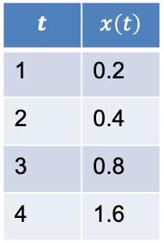
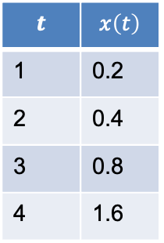
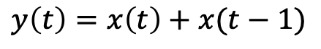
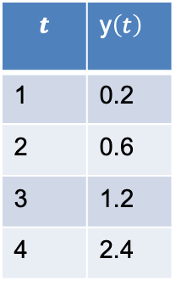
Signals & Systems
$$t$$ | $$x\left(t\right)$$
1 | 0.2
2 | 0.4
3 | 0.8
4 | 1.6
Signal
a time series
System
Transforms one signal(s) into another signal(s)
$$t$$ | $$x\left(t\right)$$
1 | 0.2
2 | 0.4
3 | 0.8
4 | 1.6
$$t$$ | y$\left(t\right)$
1 | 0.2
2 | 0.6
3 | 1.2
4 | 2.4
$$y\left(t\right)=x\left(t\right)+x(t−1)$$

Slide 15
Open Loop System (OLS)
A system/process we are given
Has measured outputs we want to control
Ex: blood glucose
Has control inputs that influence the measured output
Ex: insulin
Control inputs
OLS
Measured outputs

Slide 16
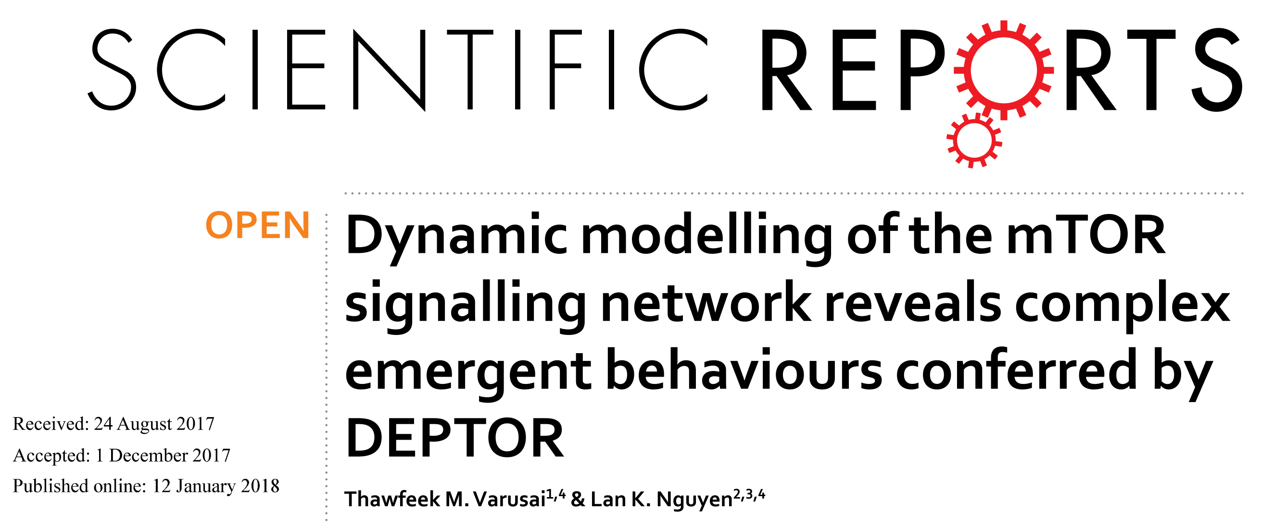
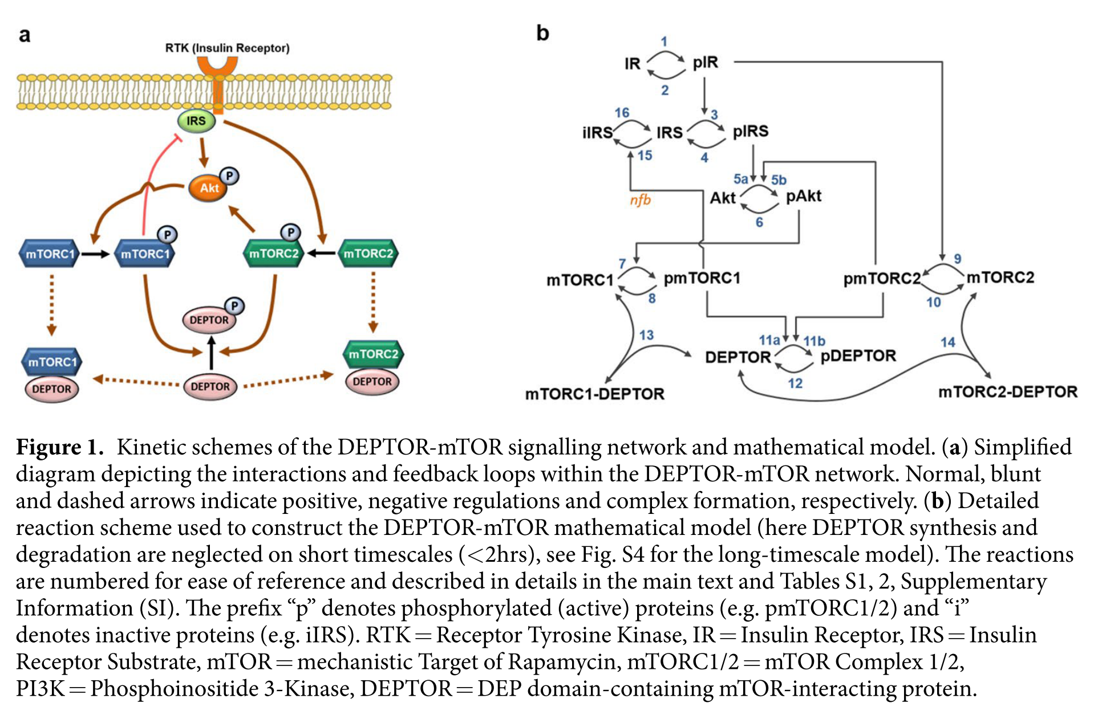
An Example: mTOR Signaling

Slide 17
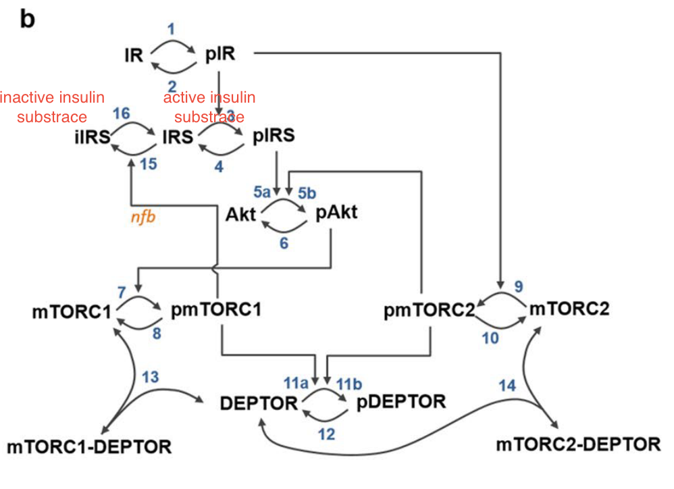
BioChemical OLS
$$J_{1}$$
Inputs (u)
Outputs (y)
mTOR
pIRS,
Akt
pmTORC1, J7
$$J_{12}$$
Inputs: Changes in species concentrations, kinetic constants
Outputs: Concentrations of floating chemical species, reaction fluxes
Must either be a state or computable from the states (e.g., conserved species, assignment statements)

Slide 18
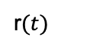

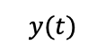
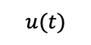
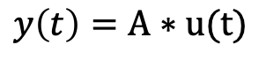


An Amplifier With Feedback
$$y\left(t\right)=A∗u(t)$$
r$(t)$
$$u(t)$$
$$y(t)$$
+
$$A$$
$$−$$
Signals
$r(t)$: reference input
$y(t)$: measured output
Notes:
Why doesn’t a filter help with measurement noise? Verify transfer functions.

Slide 19
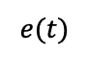

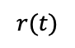

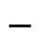

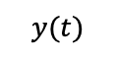
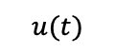
Closed Loop System (CLS)
$$r(t)$$
$$e(t)$$
$$u(t)$$
$$y(t)$$
Controller
C
+
$$OLS$$
+
$$−$$
$$Filter$$
Signals
$r(t)$: reference input
$e(t)$: control error
$y(t)$: measured output
Systems
Open loop system (OLS)
Controller
Filter
Compensation (C)
Notes:
Why doesn’t a filter help with measurement noise? Verify transfer functions.

Slide 20
Control Engineering
$$r(t)$$
$$e(t)$$
$$u(t)$$
$$y(t)$$
Controller
C
+
$$OLS$$
+
$$−$$
$$Filter$$
Given an open loop system
Construct controller and/or filter and/or compensation that achieves control objectives: stable, short settling times, accurate, …
Notes:
Why doesn’t a filter help with measurement noise? Verify transfer functions.

Slide 21
Challenges in Control Engineering of Biological Systems
Homeostasis is not our friend.
Can be difficult to find an input that affects the output
Complex activation and inhibition makes it difficult to know the direction of effects
Difficult to accurately model biological systems.

Slide 22
Exploring Feedback Control
Design for regulation
Effect of kP on stability, oscillations
Bias
Removing bias by adjusting the reference

Slide 23
BACKUP

Slide 24

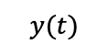
Closed Loop System (CLS)
$$r(t)$$
$$e(t)$$
$$u(t)$$
$$y(t)$$
Controller
+
$$OLS$$
+
$$−$$
$$Filter$$
Notes:
Why doesn’t a filter help with measurement noise? Verify transfer functions.

